Slide 1


Final Project: Radiation Mapping
Elliott Caton, Agustina Jolly, Vivian Smart-Stewart
Spring 2024

Slide 2
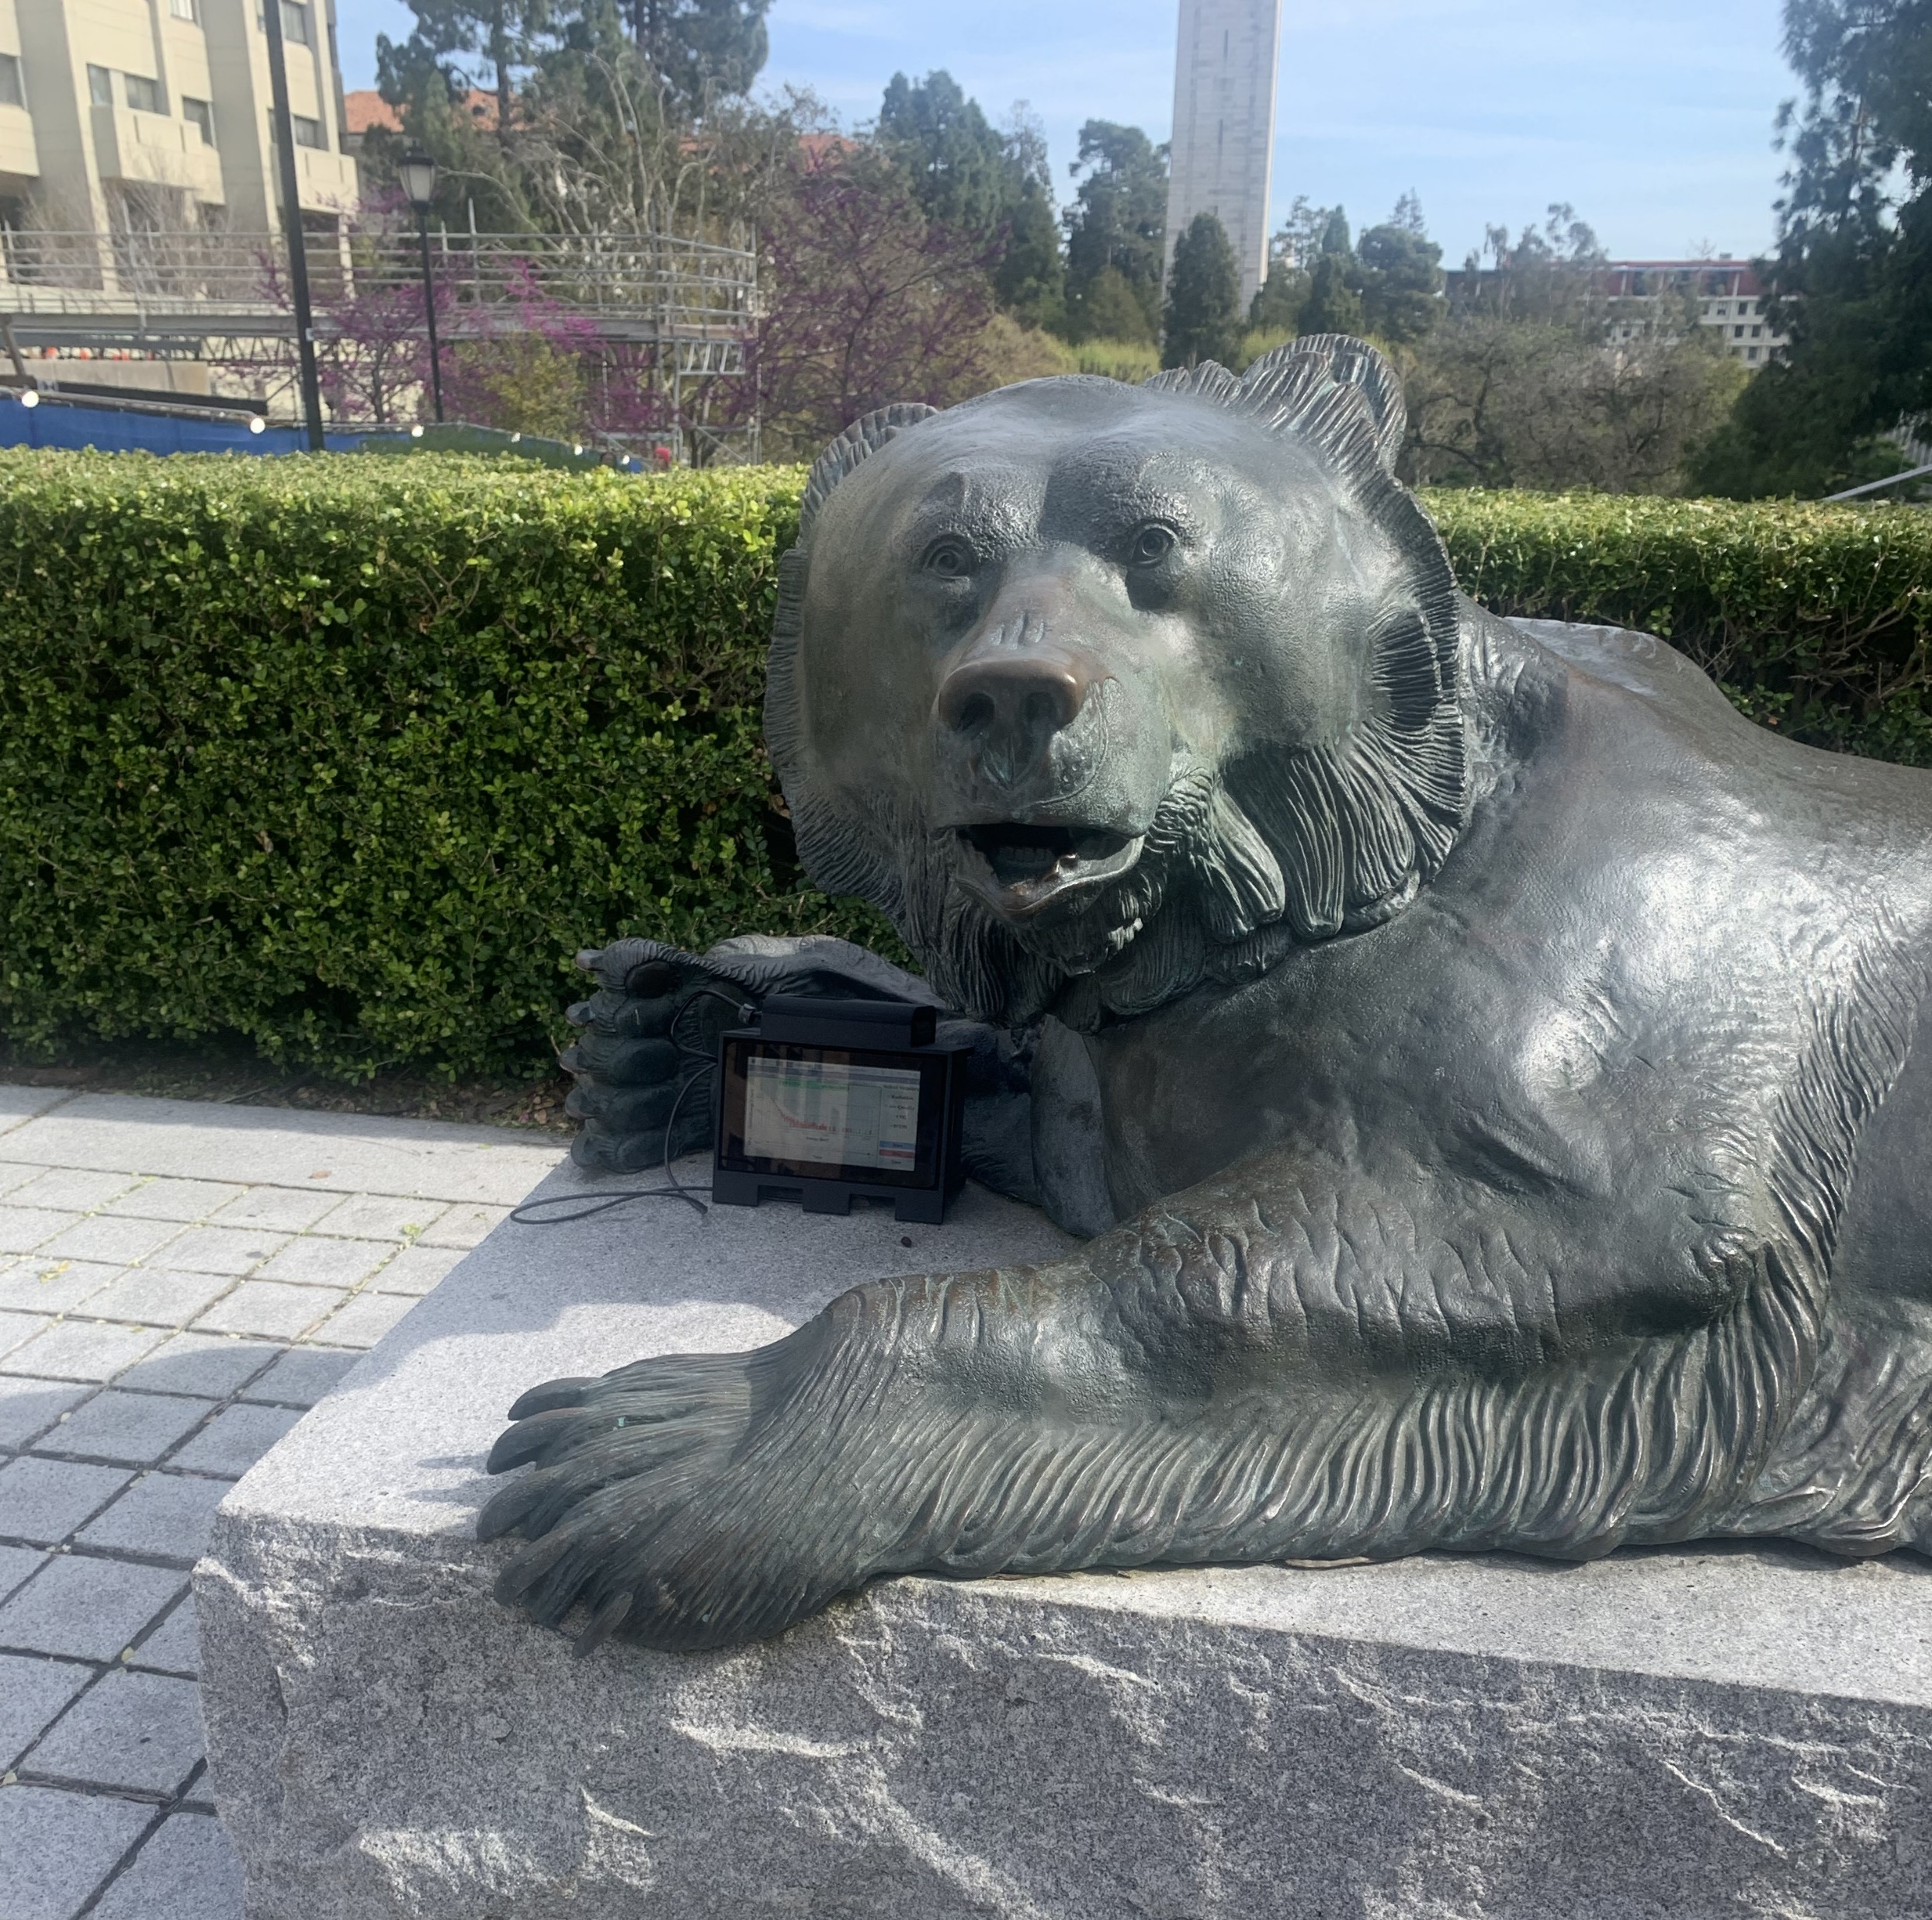
Thesis
Urban terrain alters the amount of radiation detected from natural geographic sources of radiation.
Variable Considerations:
Time of collection
Weather variation
Human presence

Slide 3
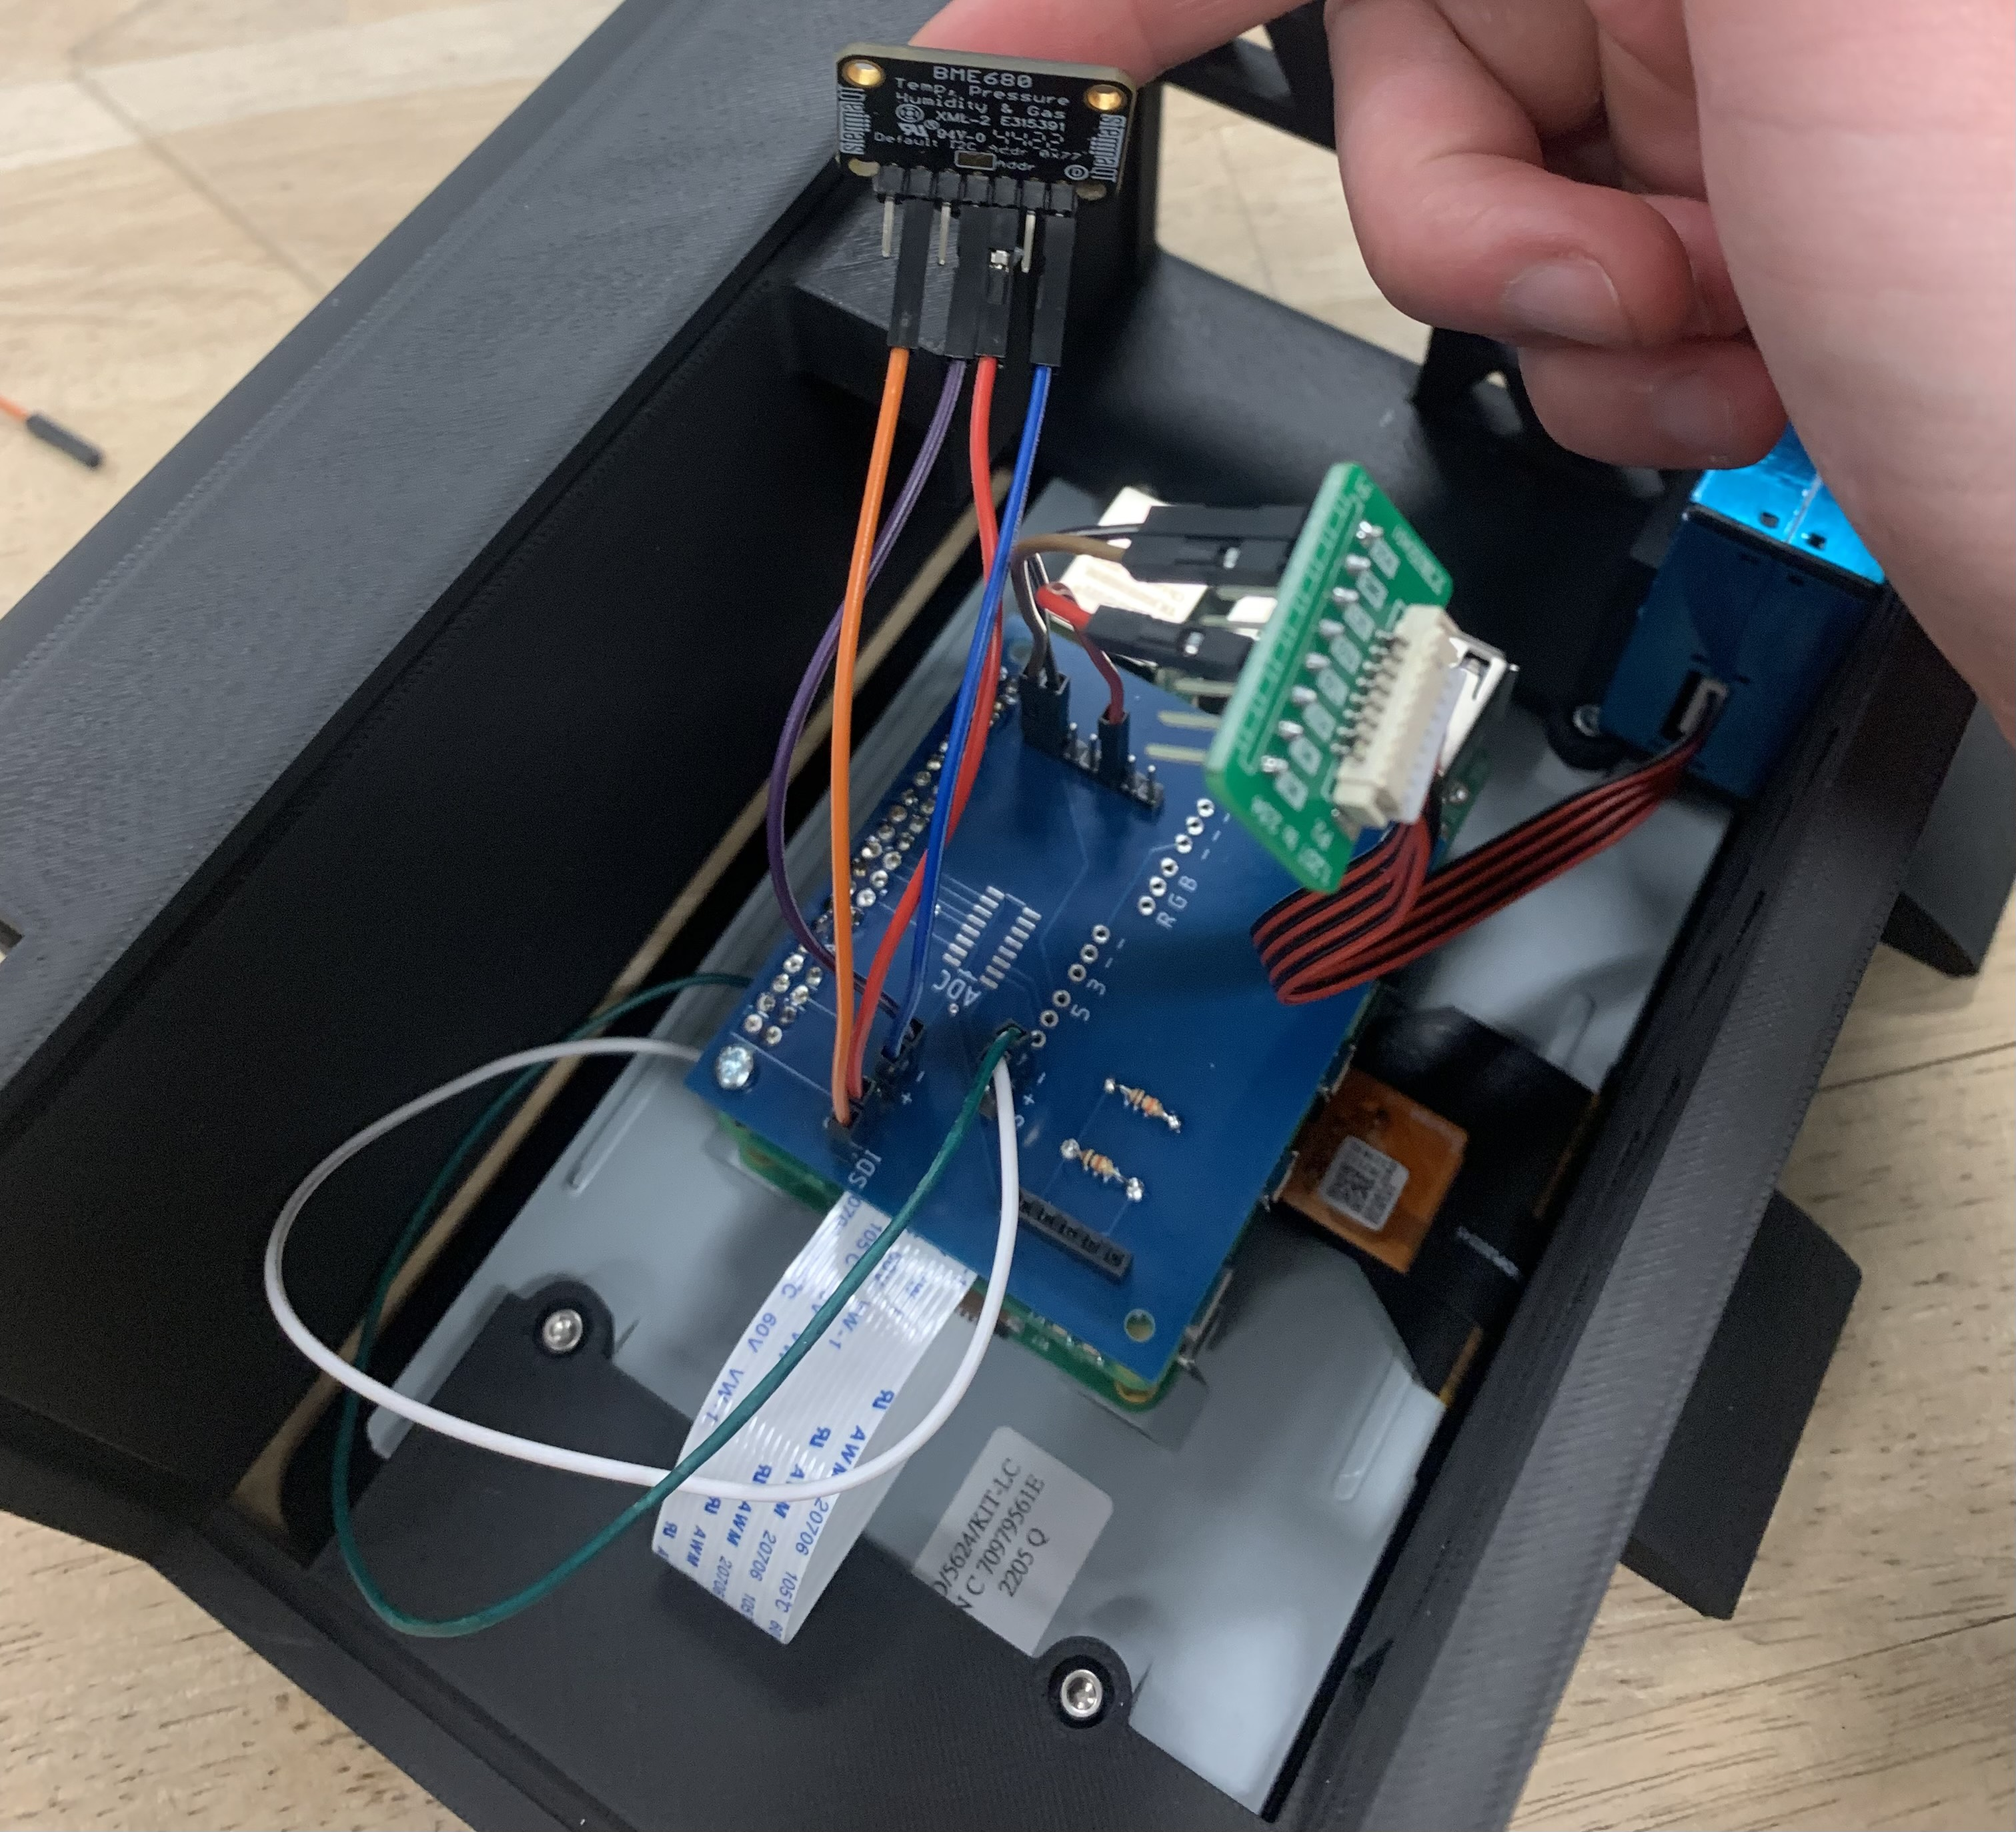
Collection Procedure
Ensure proper sensor setup and connections
Test of the detection cycle indoors
Sensor functions
Data Storage Locations
File Types (2 CSV files)
Set collection intervals
15 minutes total
2 second intervals
Repeat collection at all 7 locations
Repeat if errors occur

Slide 4
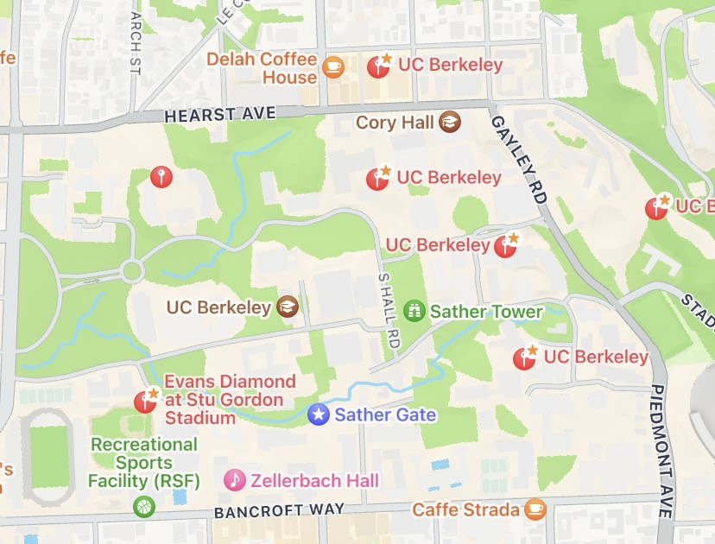
Map of Data Points
Etcheverry Breezeway
College of Chemistry Latimer Hall
McLaughlin Patio, Construction site
Gateway Construction Site
Foothill Parking lot and Amphitheatre Construction Site
Faculty Club
Stu Gordon Stadium

Slide 5
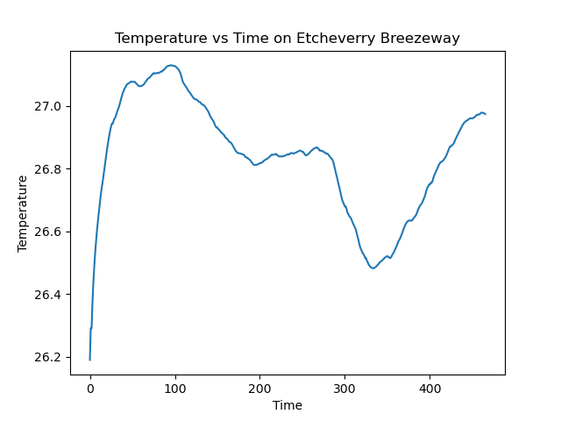
Analysis Procedure
Remove outliers due to P/T/H sensor
410 data points
Determine statistical values and graph
Mean and standard deviation
Histograms of counts
Time series plots of air quality
Plot spectrum data

Slide 6
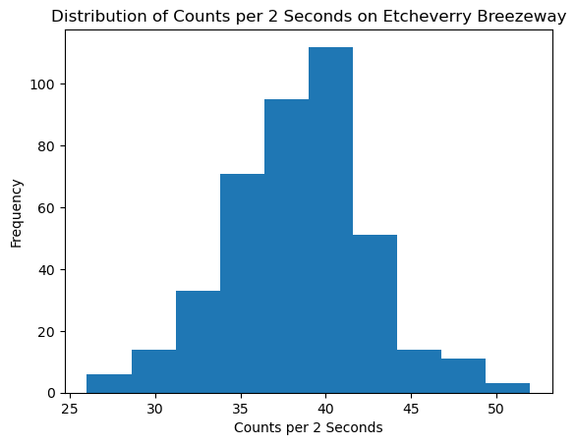
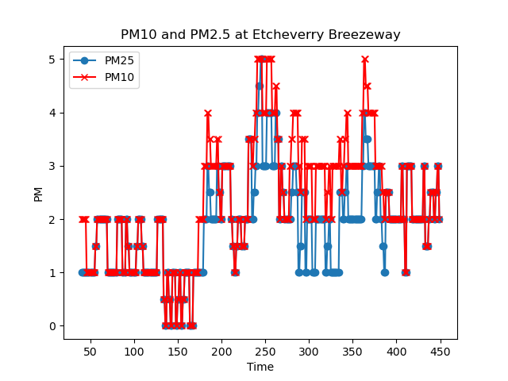
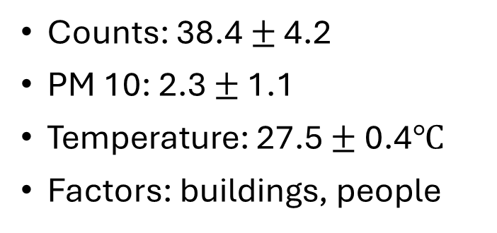
Location 1: Etcheverry Breezeway
Counts: 38.4 $±$ 4.2
PM 10: 2.3 $±$ 1.1
Temperature: 27.5 $±$ 0.4$℃$
Factors: buildings, people

Slide 7
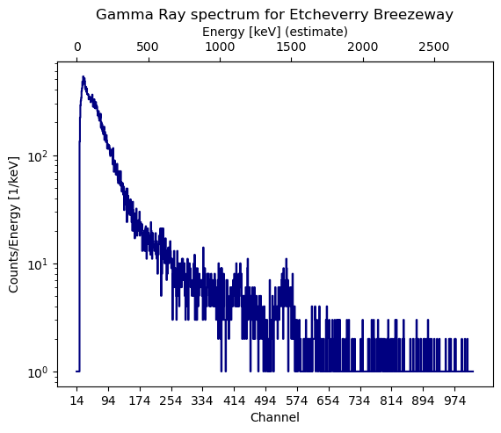
K-40 1460 keV

Slide 8
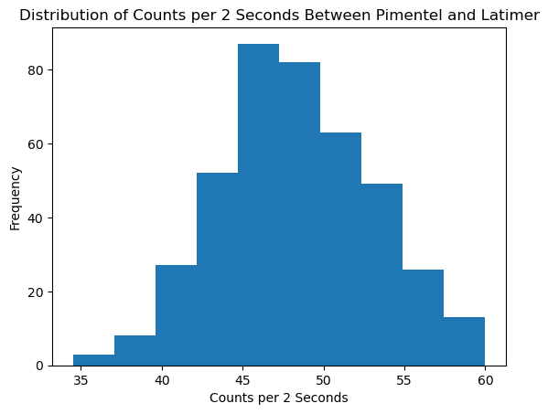
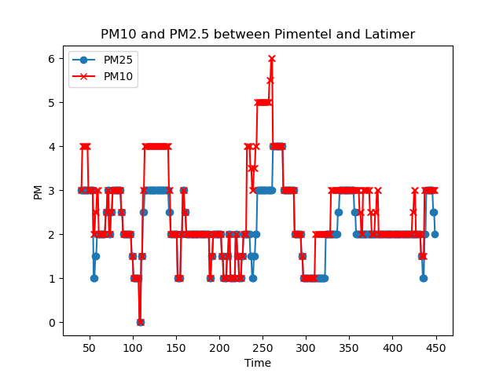
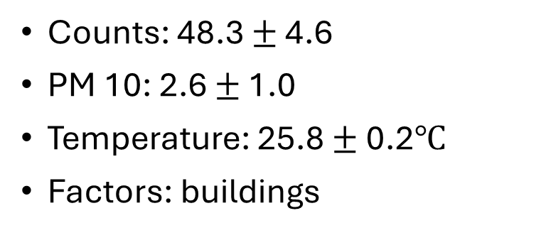
Location 2: College of Chemistry, Latimer Hall
Counts: 48.3 $±$ 4.6
PM 10: 2.6 $±$ 1.0
Temperature: 25.8 $±$ 0.2$℃$
Factors: buildings

Slide 9
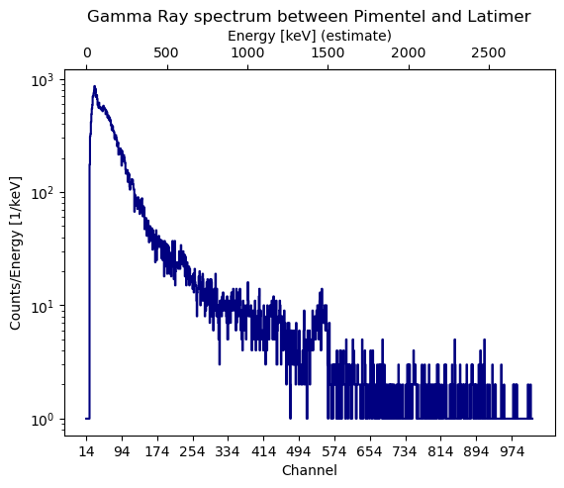
~ 600 keV

Slide 10
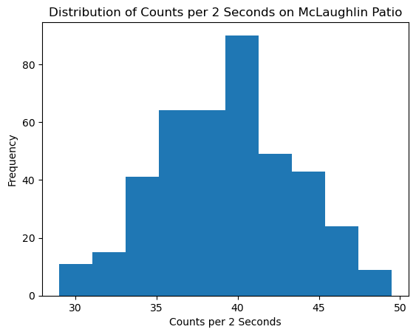
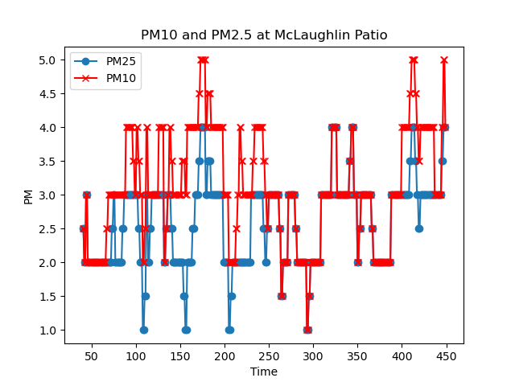
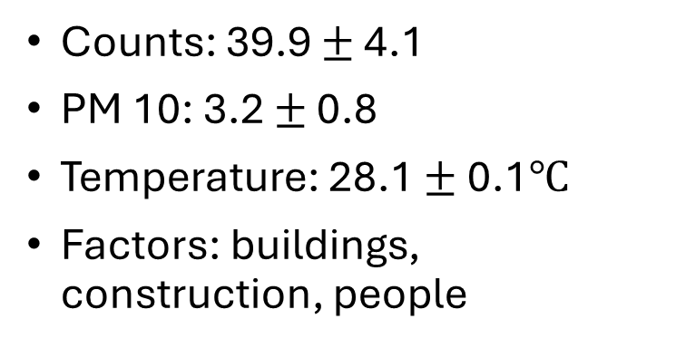
Location 3: McLaughlin Patio, Construction Site
Counts: 39.9 $±$ 4.1
PM 10: 3.2 $±$ 0.8
Temperature: 28.1 $±$ 0.1$℃$
Factors: buildings, construction, people

Slide 11
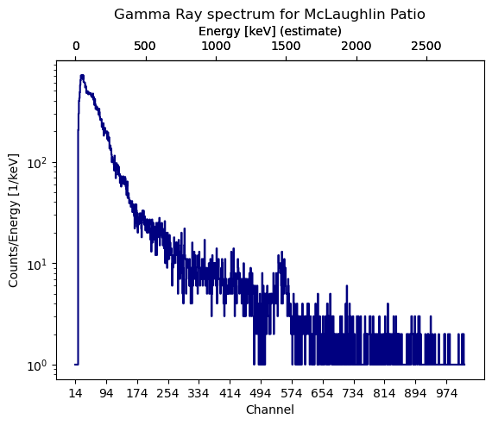

Slide 12
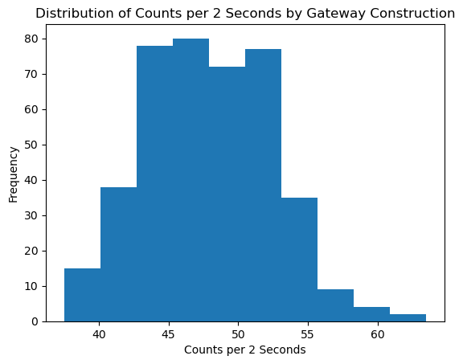
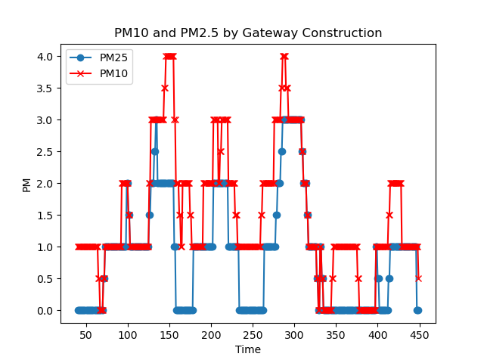
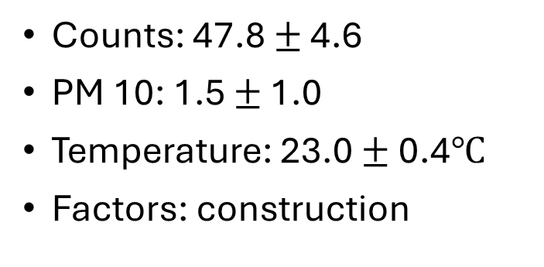
Location 4: Gateway Construction Site
Counts: 47.8 $±$ 4.6
PM 10: 1.5 $±$ 1.0
Temperature: 23.0 $±$ 0.4$℃$
Factors: construction

Slide 13
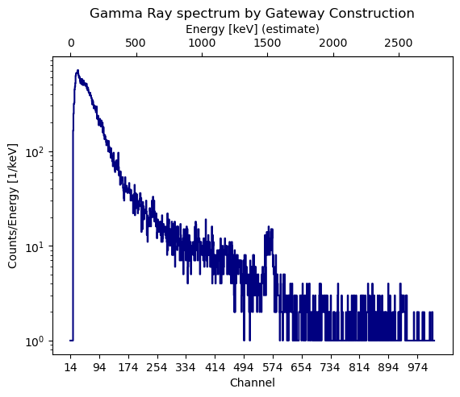

Slide 14
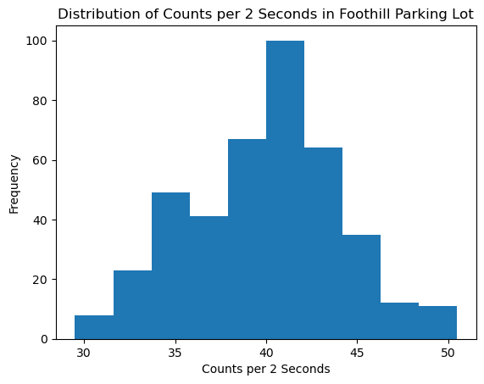
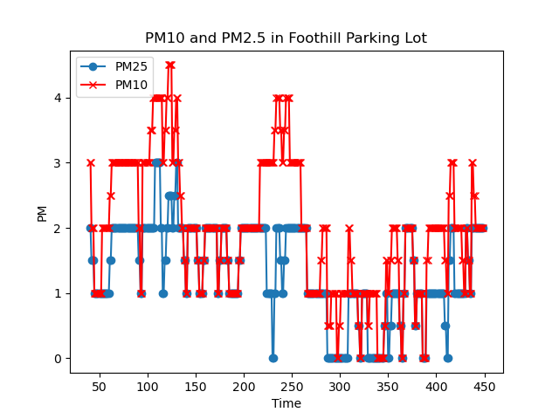
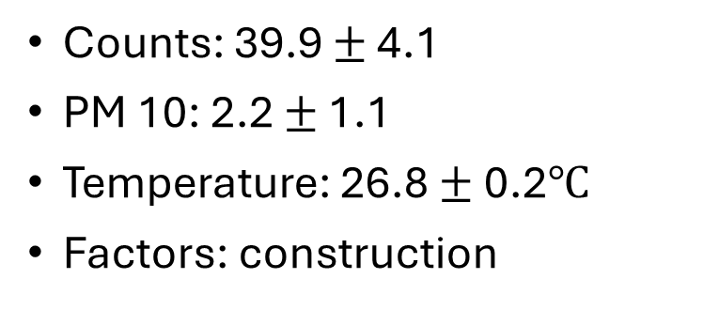
Location 5: Foothill Parking Lot and Amphitheatre Construction
Counts: 39.9 $±$ 4.1
PM 10: 2.2 $±$ 1.1
Temperature: 26.8 $±$ 0.2$℃$
Factors: construction

Slide 15
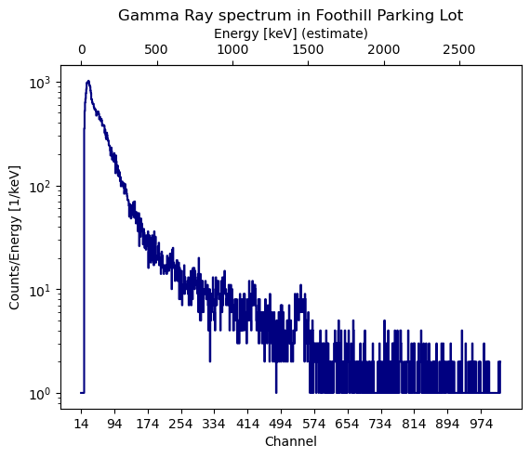

Slide 16
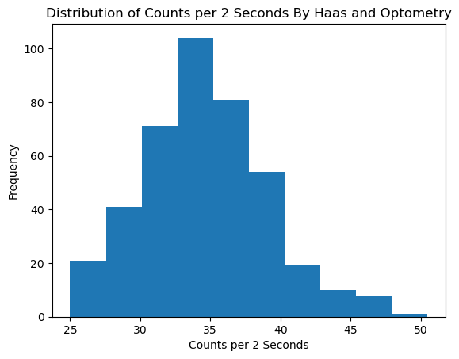
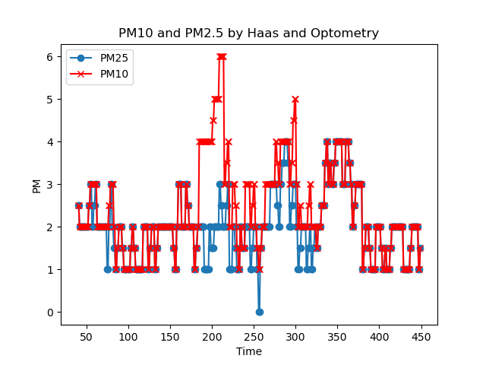
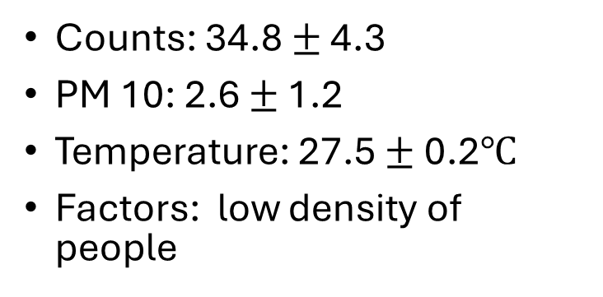
Location 6: Faculty Club
Counts: 34.8 $±$ 4.3
PM 10: 2.6 $±$ 1.2
Temperature: 27.5 $±$ 0.2$℃$
Factors: low density of people

Slide 17
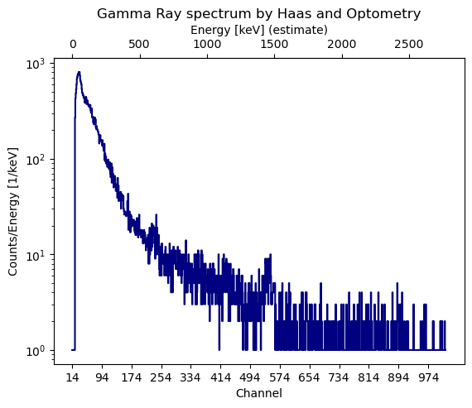

Slide 18
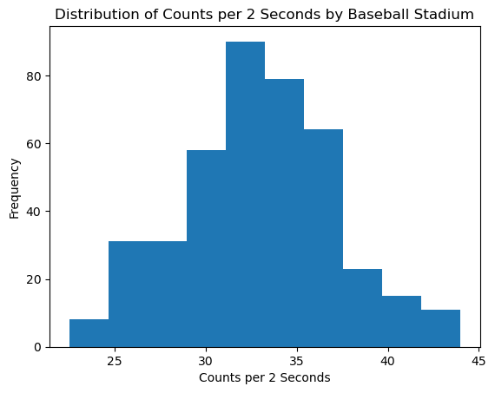
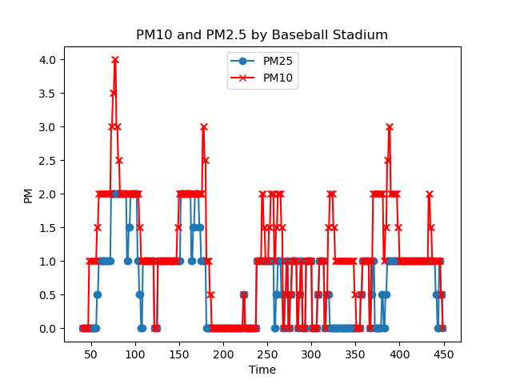
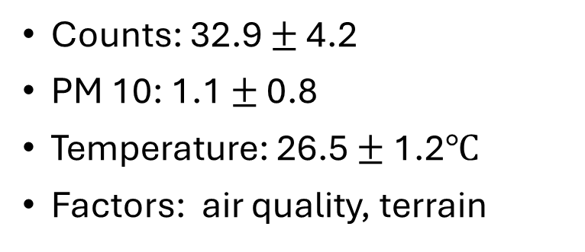
Location 7: Stu Gordon Stadium
Counts: 32.9 $±$ 4.2
PM 10: 1.1 $±$ 0.8
Temperature: 26.5 $±$ 1.2$℃$
Factors: air quality, terrain

Slide 19
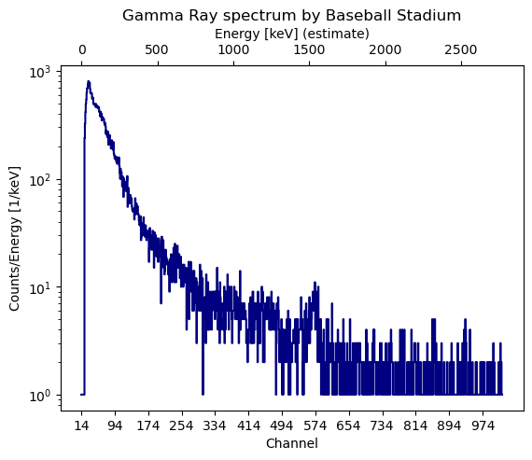

Slide 20
Irregular Data
Taking data on different days affected air quality
Need more data (longer intervals, multiple days) to notice statistically significant variations

Slide 21
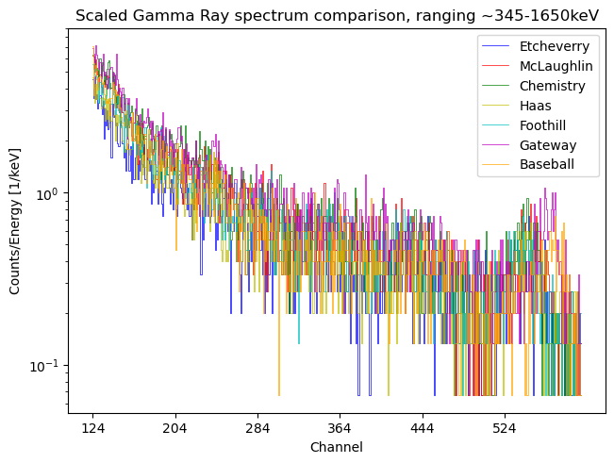
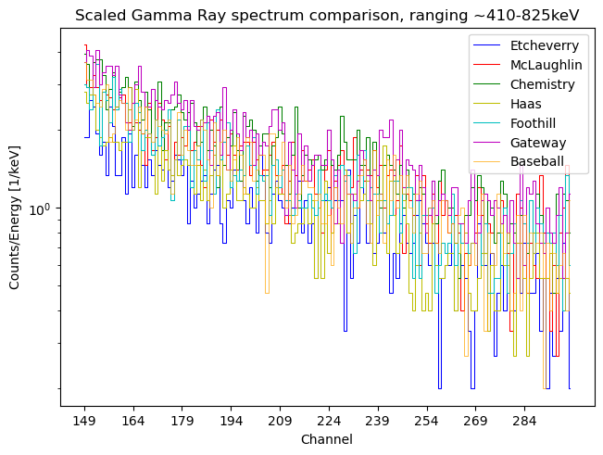
Spectrum range comparisons
~ 2.75 keV / channel based off knowing K-40 has a known peak at 1460 keV, roughly on channel 520

Slide 22
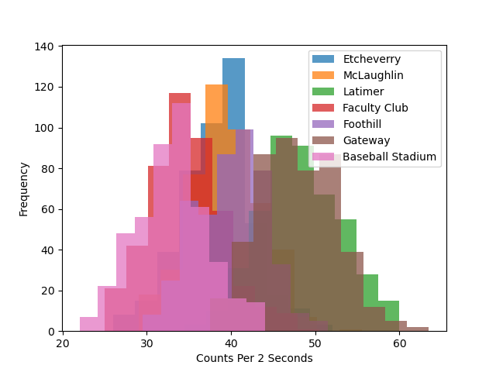
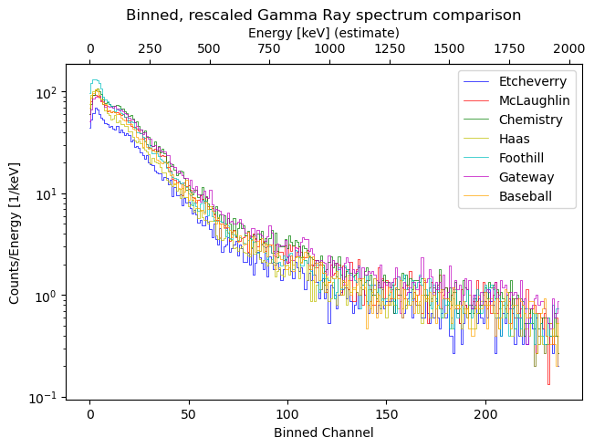
Conclusions
Active construction correlates to more counts

